Slide 1
Cyber Security Discussion
Greg Sanchez
September 18, 2015

Slide 2



General Dynamics has a bobsled team?
Maybe not, but we do have a Health Solution Business

Slide 3






General Dynamics Health Solutions

Slide 4
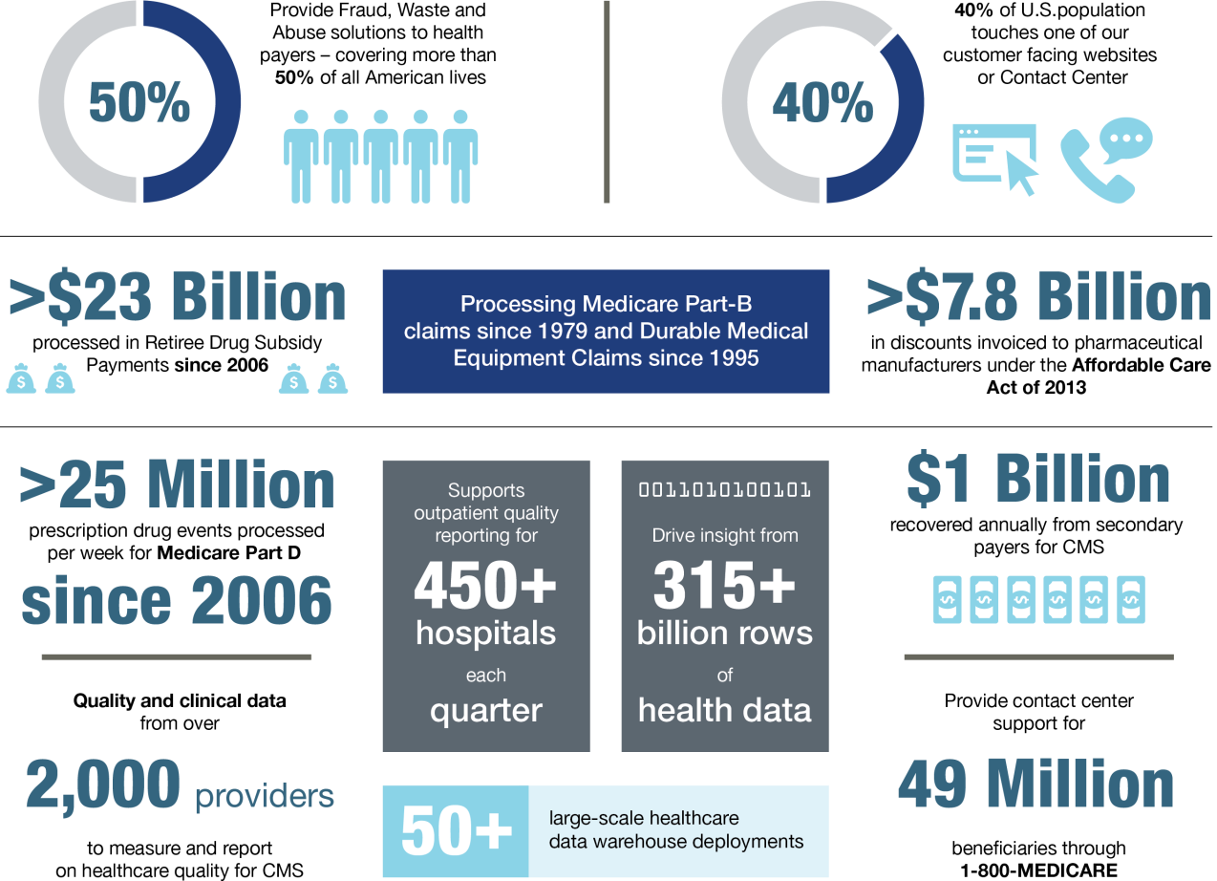
General Dynamics Health Solutions at a Glance

Slide 5
Agenda
Underlying Problems Requiring Cyber Security
Things You are Already Doing
New Thoughts on Data Protection

Slide 6

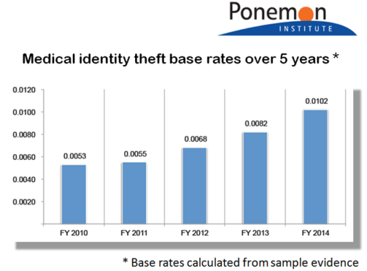
Health Data’s Increasing Risk
“
Credit cards can be say $5+ where PHI records can go from $20 say up to -- we've even seen $60 or $70…
Jim Trainor
FBI's Cyber Security
”
“
For the first time in over a decade, the healthcare sector surpassed the business sector as the industry with the most data security breaches at 43% of all breaches.
”
Notes:
One credit card number might be around $10
Get the magnetic strip and now you got $20
Recent stat I just heard earlier this week is the health records from the Anthem breach were going for as much as $400

Slide 7
The Underlying Needs for Cyber Security
We can bucket the issues into a small set
Software and system
Technology implementation
Insider threat
Social engineering (our employees)
Notes:
Greg’s notes – I like to understand the underlying issues of any problem. With cyber security we seem focused
On another tool and addressing the problem but we need to make sure we understand what is causing the issue
Software – we see continuous issues related to software patching, vulnerabilities – name the software – firefox, IE, OS, Adobe – how might the cloud shift things – IaaS nothing but what about SaaS – who gets reputational impact and financial impact – do not forget anything that has an IP address has software and that means it can be vulnerable - we have seen Hospital Medical Devices Used As Weapons In Cyberattacks (Insulin pumps, heart monitors, x-ray systems)
Tech Impl – How do we minimize errors – yes we might have a FW but what if we leave it wide open, how do we make sure we properly implementing and configuring our hardware and software security solutions? ->bring up program issue without naming the program
Insider Threat – I remember when I was little and my dad worked for Kodak – in those days he carried a briefcase. If we wanted to leave with something is was probably big and visible – all briefcases were checked upon exit – no longer the case – take info from recent metatalk report
Social Engineering – making sure our people are trained – emails from our banks, links, emails from people we think are in our org

Slide 8
What We Will Not Discuss
Here are the things you already know
Patching
Risk assessments
Risk management and mitigation
Visibility
Training

Slide 9
Patching
“Untrustworthy software is responsible for over 90 percent of data breaches worldwide”¹
“…Delaying patching leaves systems exposed to failure and compromise – a risk which will eventually happen, and from which a business can struggle to recover.”²
“Security study shows that 44 percent of breaches could be attributed to patched vulnerabilities that were between 2 and 4 years old”³
July 02, 2015: Importance of patching: government teams up with software companies; http://www.scmagazineuk.com/importance-of-patching-government-teams-up-with-software-companies/article/424212/
August 06, 2015: Poor patching is still one of the biggest security issues; http://www.scmagazineuk.com/poor-patching-is-still-one-of-the-biggest-security-issues/article/429685/
2015-02-23: Lack of Patching Remains a Top Security Risk, HP Report Finds; http://www.eweek.com/security/lack-of-patching-remains-a-top-security-risk-hp-report-finds.html

Slide 10
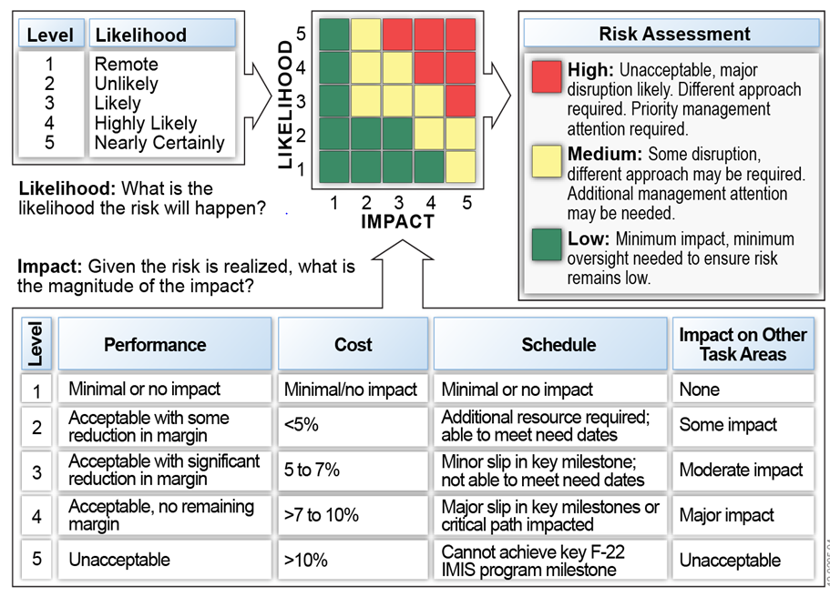
Risk Assessment

Slide 11

Risk Management and Mitigation
Step 1: Identify
and Record
Step 3: Plan and Resource
Step 4: Handle
and Monitor
Step 2: Analyze and Assess
  Identify Potential Risks
  Enter in Risk Register
  Assumption Testing
  Data About the Risk
  Understand the Risk
Quantify Risk
  Cost, Schedule, Performance
Event Analysis
Relational analysis with existing risks and open issues
Cost / Schedule
Impacts
Probability of
Occurrence (R_{P})
Impact of
Occurrence (R_{I})
Risk Mgt
Establish Risk Triggers
Handling Strategy
Contingency Plan
Assign Resources
Escalate?
Implement Handling Strategy
Update IMS Modification / Change Order
Monitor Actions
Reassess
Risk Exposure
High or Moderate
RIOM Board Reassessment
Risk Handling Replanning
Revised Handling Plan
Database
Risk Exposure
is Low
Program
and Risk Management Tools
Step 3b
Step 3a
Contingency Plan
Step 5:
Handling
Risk Watch List
Risk Has Been Handled
Step 7: Document
Step 6: Closeout
Lessons Learned
Retire Risk
Key
Planned
Replanning

Slide 12
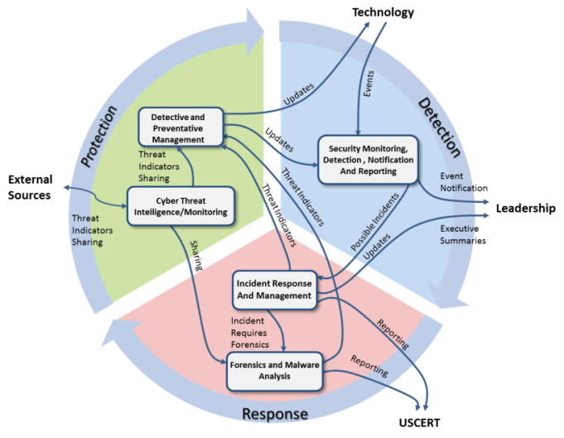
Visibility – SOC and SOC as a Service
SOC as a Service provides the monitoring, analysis and response to internal and external malicious threats to protect your organization’s digital assets.
Security monitoring, detection, notification and reporting
Incident response and management
Cyber threat intelligence/monitoring
Detective and preventative management
Forensics and malware analysis
SOC IT operations and maintenance
Security research and engineering
Vulnerability assessment and compliance
Penetration testing
Continuous monitoring
Insider threat monitoring
Security incidents trend analysis
Data loss prevention

Slide 13
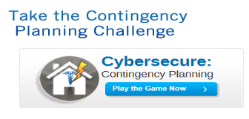
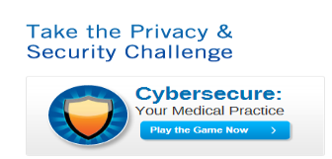
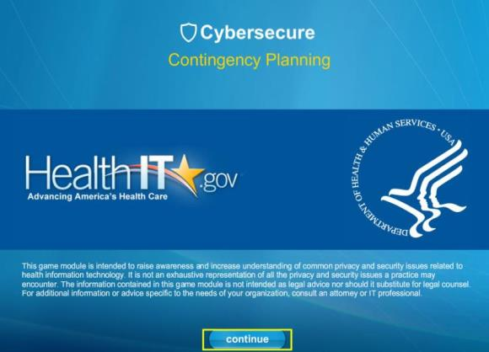
Privacy and Security Training Games
2011: We lead development of web-based training for
cybersecurity
2012: ONC launches it’s first security training game
30+ favorable Articles
www.healthit.gov/providers-professionals/privacy-security-training-games
GDIT Proprietary

Slide 14
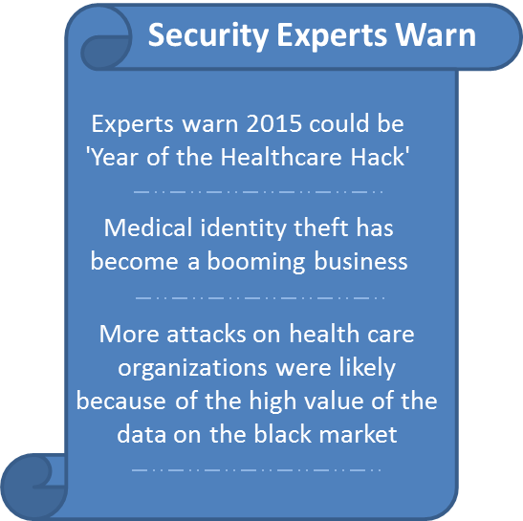
Established Program to Safeguard Sensitive Customer Data
Increased state regulation of handling and protection of online personal data and financial information (FL, CA, IN)
Data security violations come at a heavy financial cost: from a minimum of $42 per record in India to a high of $199 per record in Germany. The average financial impact in the United States was estimated at $188 per record with an incident cost of $5.4 million.
Employees are your best, first line of defense or your weakest, most vulnerable point
The General Dynamics Health Solutions Culture of Responsibility is our data security philosophy
HHS Breaches of Unsecured Protected Health Information

Slide 15
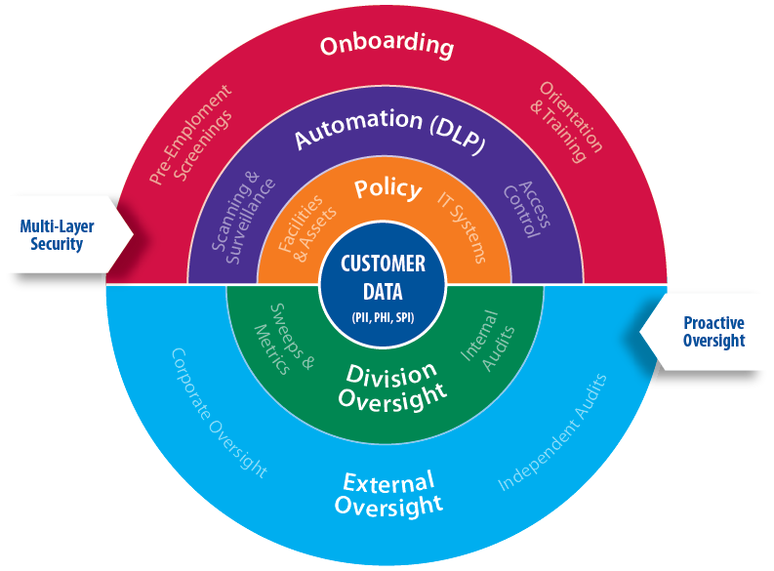
Culture of Responsibility Focus Areas

Slide 16
Breakdown of Culture of Responsibility Focus Areas
Culture of Responsibility Protecting Customer Data (PII, PHI and SPI)
 | Pre-Employment Background Checks
 | Reid Report® Recruiting Assessment
 | Orientation – Awareness & Training (Day 1)
 | Site/Contract Specific – Orientation & Training (Weeks 3-4)
 | DLP – Message & Application Transaction Scanning
 | Permissions & Access Control
 | Surveillance & Forensics
 | 01 Control of Operational Areas
 | 02 Protection of Customer Data
 | 03 Control of Sensitive Customer Documentation
 | 04 Control of Mobile Assets
 | 05 Vendor Security Impact Assessment
 | 06 Opportunity Security Risk Review
 | Site Sweeps
 | Site Metrics & Internal Audits
 | Performance Objectives for Management Chain
 | Corporate Board Oversight of Data Management Program
 | Corporate Data Security Committee & Data Security Annual Report
Onboarding
Automation (DLP)
Multi-Layer Security
Policy
Division
Proactive
Oversight
External

Slide 17

High-Level Culture of Responsibility (Automation)
1
Protect SPI from being published outside the environment through web-based applications
2
Protect SPI from inappropriately being stored on end user devices
3
Protect SPI from inappropriately being transferred (internal or external)
3
Discover internal data repositories (e.g., file shares, SharePoint)
Social Media
URL

Slide 18
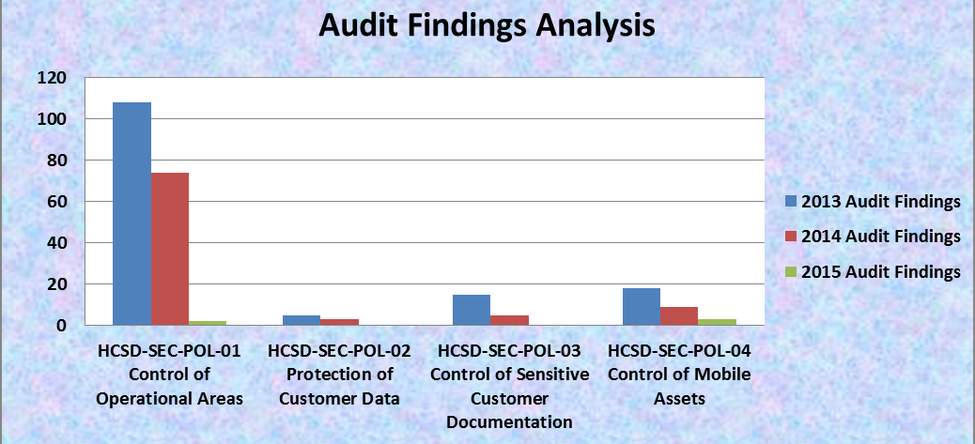
Culture of Responsibility Program Maturity
COR audits demonstrate continued trend in maturity growth
Strong year over year decline in audit findings

